Slide 2
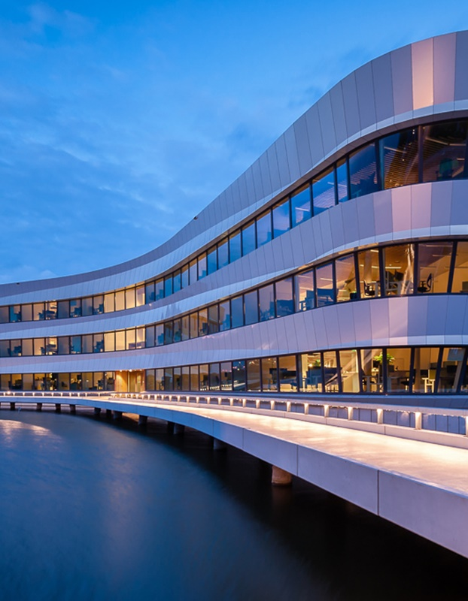

R shiny
Lunch lecture
Examples
Willem Stolte
25 feb 2020

Slide 3
Demo AqMad https://deltares.shinyapps.io/rAqmad client: STOWA Users: Water boards rebuilt from Excel macro to be used throught www

Slide 4
DemoWesterschelde WQ https://deltares.shinyapps.io/WesterscheldeWaterQuality Client: RWS Aim: explorative data view/analysis

Slide 5
Demo “doorlaatmiddel Grevelingen" https://shinyapps.webservices.deltares.nl/deltares/doorlaatmiddelgrevelingen/ client: RWS Users: Project workers/RWS project leader aims: - interactively browse through platitude of graphs - compare different scenarios

Slide 6
Advantage
Interactivity
Quick and cheap to set up (doorlaatmiddel, WQ Westerschelde), ideal for prototyping
Pretty advanced functionality combined with R statistics/visualization (AQMAD) is possible, but will of course take more time

Slide 7




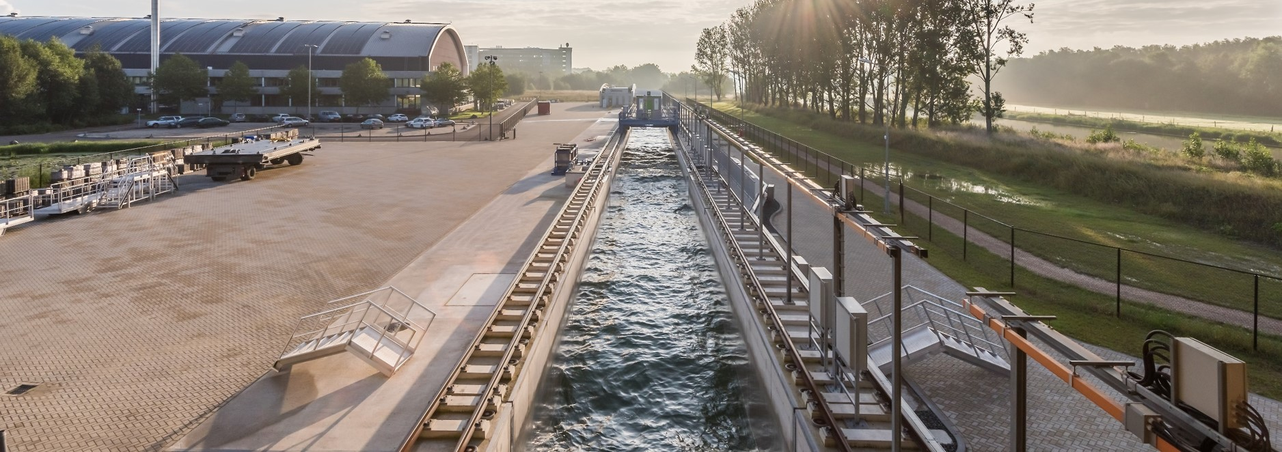

Contact
www.deltares.nl
linkedin.com/company/deltares
info@deltares.nl
facebook.com/deltaresNL
facebook.com/deltaresNL
linkedin.com/company/deltares
@deltares
@deltaresNL

